Slide 1


Chapter 2
DLI
Solutions of Equations in One Variable
introduction

Slide 2
Lecture 2-1
DLI
The Bisection Method
二分法

Slide 3
DLI
Example
Given the equation $f\left(x\right)=x^{3}−x−1=0$, find the interval of the root.

Slide 4
DLI
In this chapter
the root-finding problem--one of the most basic problems of numerical approximation.
Bisection Technique
1.Bisection
The first technique, based on the Intermediate Value Theorem, is called the
Bisection, or Binary-search, method.

Slide 5
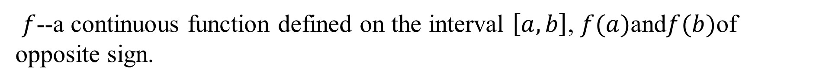
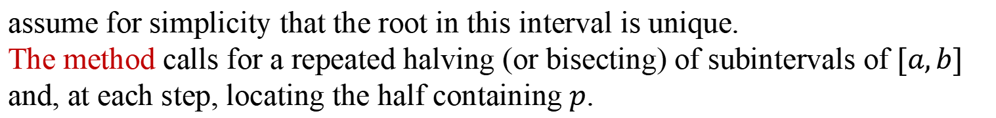
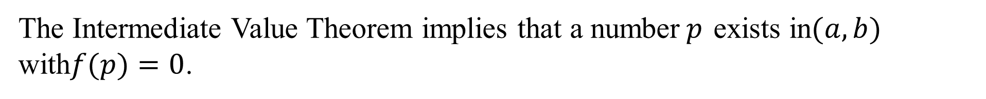
DLI
$f$--a continuous function defined on the interval $\left[a,b\right]$, $f(a)$and$f(b)$of opposite sign.
The Intermediate Value Theorem implies that a number$p$ exists in$(a,b)$ with$f(p)=0$.
assume for simplicity that the root in this interval is unique.
The method calls for a repeated halving (or bisecting) of subintervals of $[a,b]$ and, at each step, locating the half containing$p$.

Slide 6
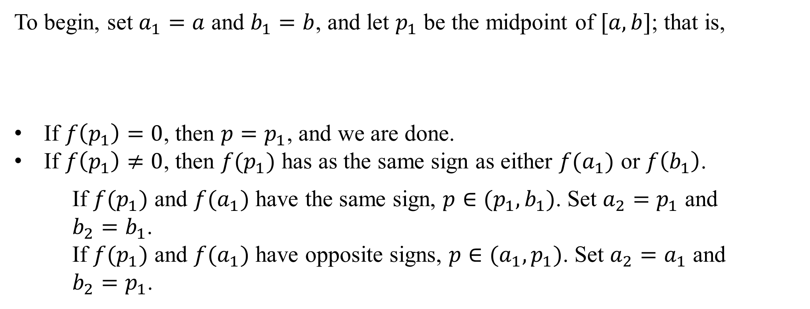
DLI
To begin, set $a_{1}=a$ and $b_{1}=b$, and let $p_{1}$ be the midpoint of $[a,b]$; that is,
If $f\left(p_{1}\right)=0$, then $p=p_{1}$, and we are done.
If $f\left(p_{1}\right)≠0$, then $f(p_{1})$ has as the same sign as either $f(a_{1})$ or $f\left(b_{1}\right)$.
If $f(p_{1})$ and $f(a_{1})$ have the same sign, $p∈(p_{1},b_{1})$. Set $a_{2}=p_{1}$ and
$b_{2}=b_{1}$.
If $f(p_{1})$ and $f(a_{1})$ have opposite signs, $p∈(a_{1},p_{1})$. Set $a_{2}=a_{1}$ and
$b_{2}=p_{1}$.

Slide 7
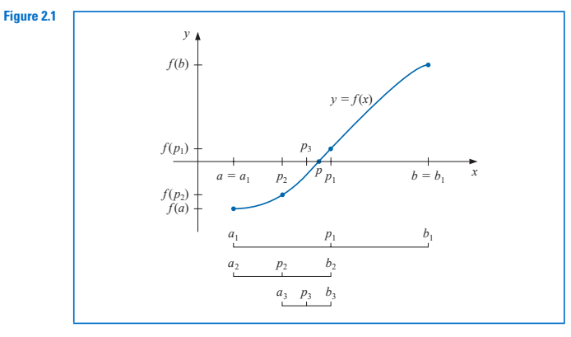
DLI
Then reapply the process to the interval . This produces the method described in Algorithm 2.1.

Slide 8
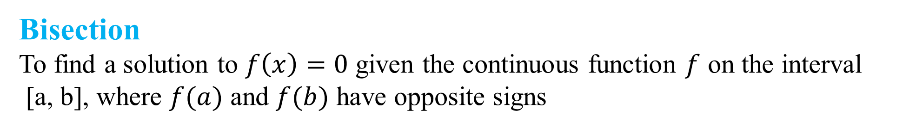
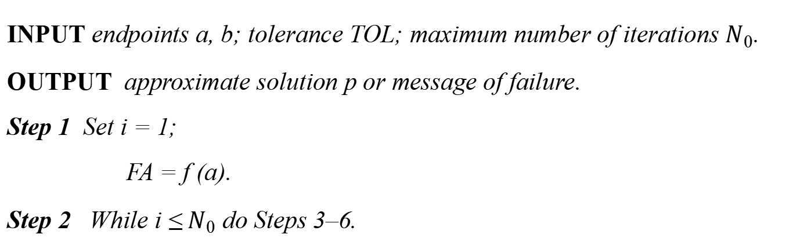
DLI
Bisection
To find a solution to $f\left(x\right)=0$ given the continuous function $f$ on the interval
[a, b], where $f(a)$ and $f(b)$ have opposite signs
INPUT endpoints a, b; tolerance TOL; maximum number of iterations $N_{0}$.
OUTPUT approximate solution p or message of failure.
Step 1 Set i = 1;
FA = f (a).
Step 2 While i ≤ $N_{0}$ do Steps 3–6.

Slide 9
DLI
Step 3 Set p = a + (b − a)/2; (Compute pi.)
FP = f ( p).
Step 4 If FP = 0 or (b − a)/2 < TOL then
OUTPUT (p); (Procedure completed successfully.)
STOP.
Step 5 Set i = i + 1.
Step 6 If FA · FP > 0 then set a = p; (Compute a_{i}, b_{i}.)
FA = FP
else set b = p. (FA is unchanged.)

Slide 10
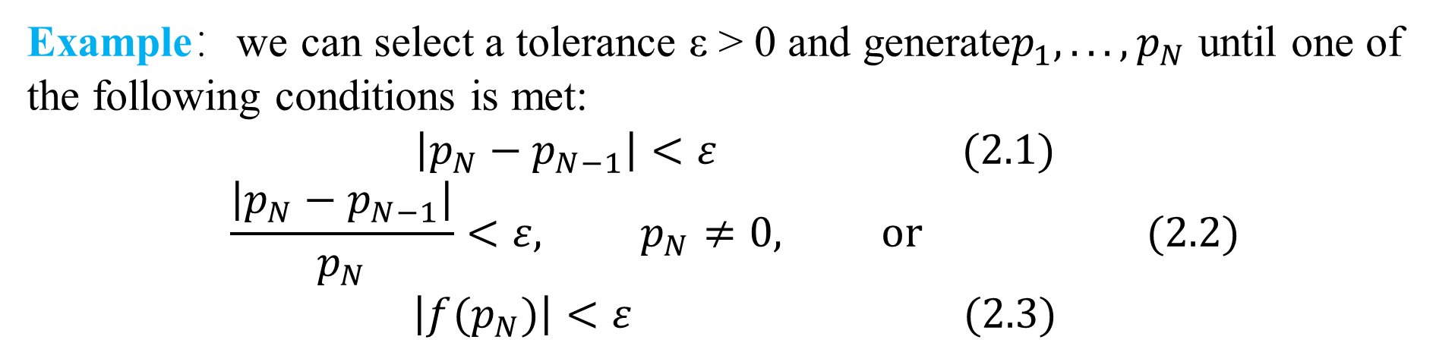
DLI
Step 7 OUTPUT (‘Method failed after N₀ iterations, N₀ =’, N₀);
(The procedure was unsuccessful.)
STOP.
Other stopping procedures can be applied in Step 4 of Algorithm 2.1 or in any of
the iterative techniques in this chapter.
Example：we can select a tolerance ε > 0 and generate$p_{1},...,p_{N}$ until one of the following conditions is met:
$$\left|p_{N}−p_{N−1}\right|<ε (2.1)$$
$$\frac{\left|p_{N}−p_{N−1}\right|}{p_{N}}<ε, p_{N}≠0, or (2.2)$$
$$\left|f(p_{N})\right|<ε (2.3)$$

Slide 11
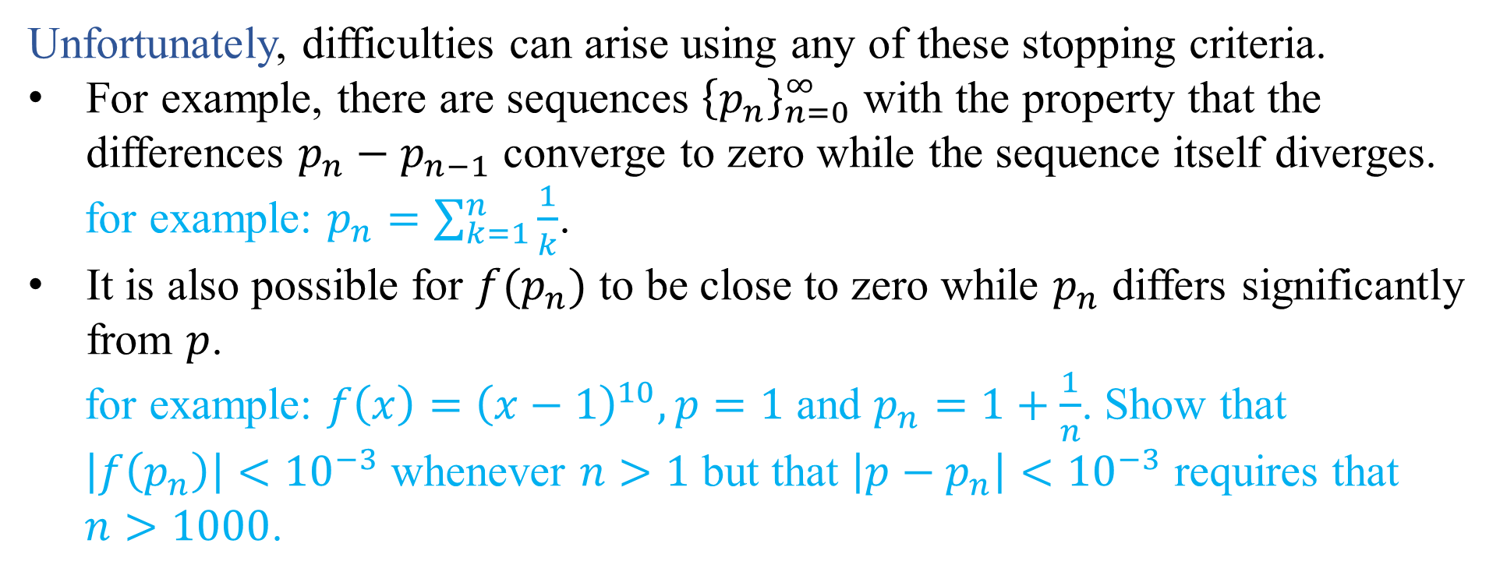
DLI
Unfortunately, difficulties can arise using any of these stopping criteria.
For example, there are sequences ${\left\{p_{n}\right\}}_{n=0}^{∞}$ with the property that the differences $p_{n}−p_{n−1}$ converge to zero while the sequence itself diverges.
for example: $p_{n}=\sum_{k=1}^{n}{\frac{1}{k}}$.
It is also possible for $f(p_{n})$ to be close to zero while $p_{n}$ differs significantly from $p$.
for example: $f\left(x\right)={\left(x−1\right)}^{10},p=1$ and $p_{n}=1+\frac{1}{n}$. Show that
$\left|f\left(p_{n}\right)\right|<{10}^{−3}$ whenever $n>1$ but that $\left|p−p_{n}\right|<{10}^{−3}$ requires that
$n>1000$.

Slide 12
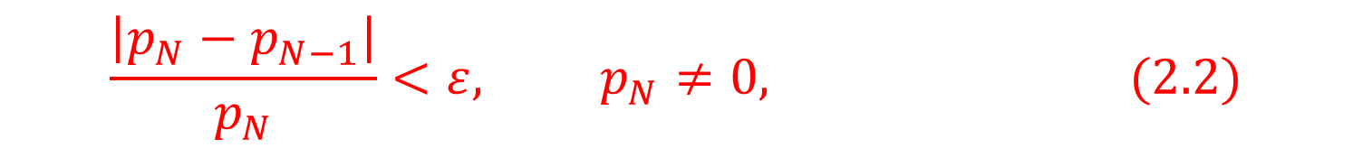
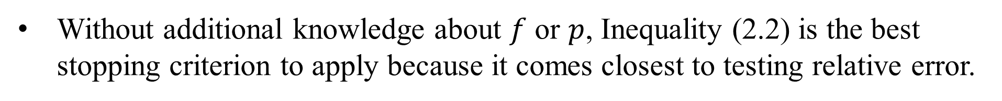
DLI
Without additional knowledge about $f$ or $p$, Inequality (2.2) is the best stopping criterion to apply because it comes closest to testing relative error.
$$\frac{\left|p_{N}−p_{N−1}\right|}{p_{N}}<ε, p_{N}≠0, (2.2)$$
Note: When using a computer to generate approximations, it is good practice to set an upper bound on the number of iterations.
This eliminates the possibility of entering an infinite loop, a situation that can arise when the sequence diverges (and also when the program is incorrectly coded).

Slide 13
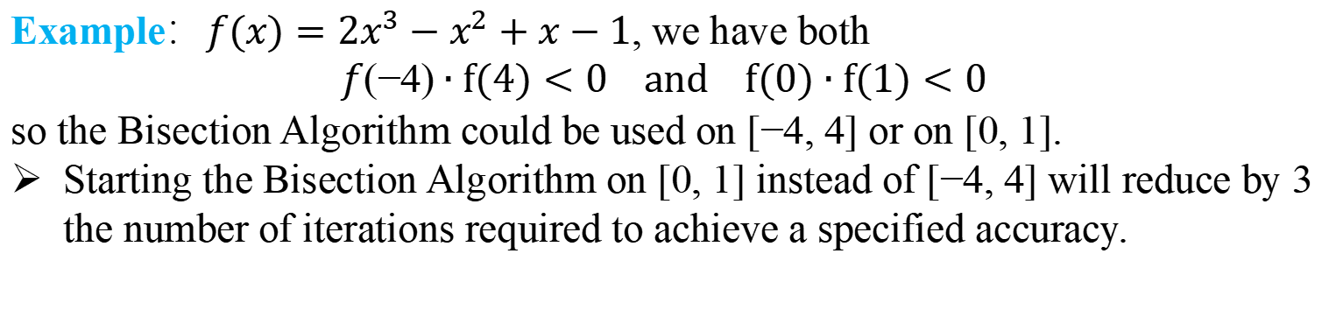
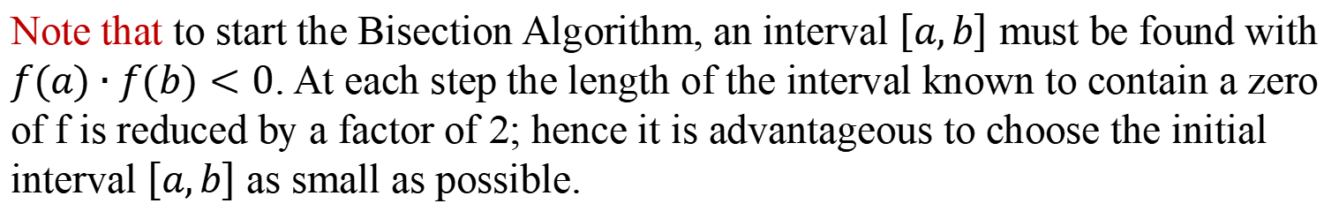
DLI
Note that to start the Bisection Algorithm, an interval $\left[a,b\right]$ must be found with $f(a)∙f(b)<0$. At each step the length of the interval known to contain a zero of f is reduced by a factor of 2; hence it is advantageous to choose the initial interval $\left[a,b\right]$ as small as possible.
Example：$f(x)=2x^{3}−x^{2}+x−1$, we have both
$$f(−4)∙f(4)<0 and f(0)∙f(1)<0$$
so the Bisection Algorithm could be used on [−4, 4] or on [0, 1].
Starting the Bisection Algorithm on [0, 1] instead of [−4, 4] will reduce by 3 the number of iterations required to achieve a specified accuracy.

Slide 14
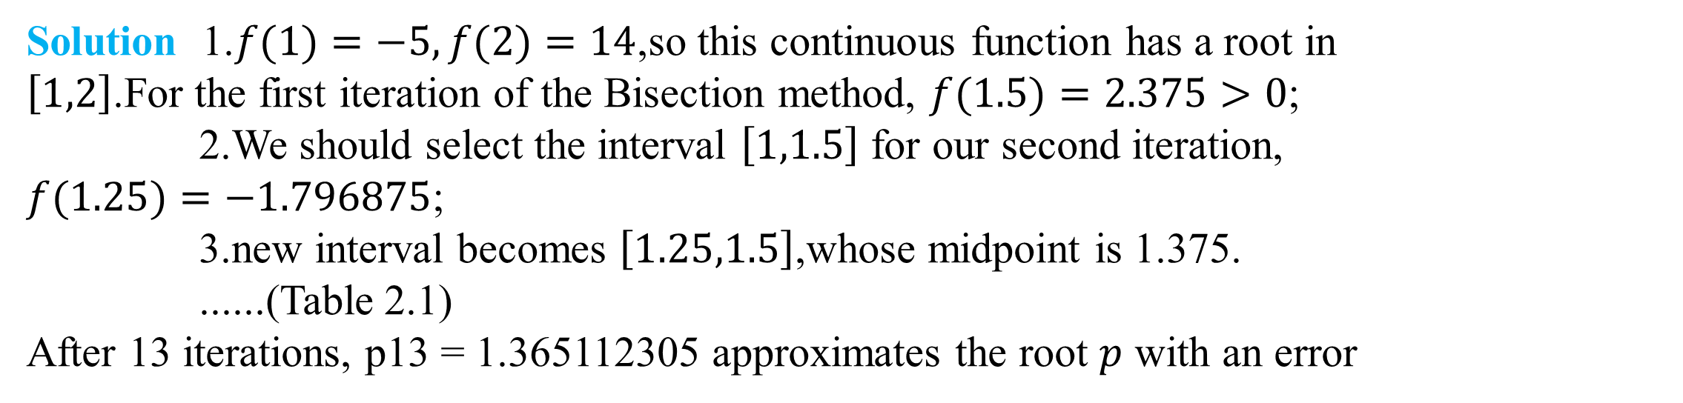
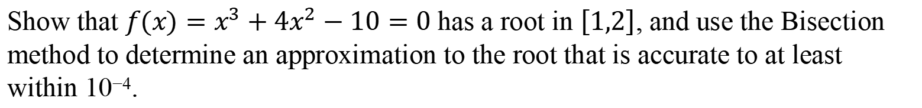
DLI
Example 1
Show that $f(x)=x^{3}+4x^{2}−10=0$has a root in $\left[1,2\right]$, and use the Bisection method to determine an approximation to the root that is accurate to at least within 10⁻⁴.
Solution 1.$f(1)=−5,f(2)=14$,so this continuous function has a root in $\left[1,2\right]$.For the first iteration of the Bisection method, $f(1.5)=2.375>0$;
2.We should select the interval $\left[1,1.5\right]$ for our second iteration, $f(1.25)=−1.796875$;
3.new interval becomes $\left[1.25,1.5\right]$,whose midpoint is 1.375.
......(Table 2.1)
After 13 iterations, p13 = 1.365112305 approximates the root $p$ with an error

Slide 15
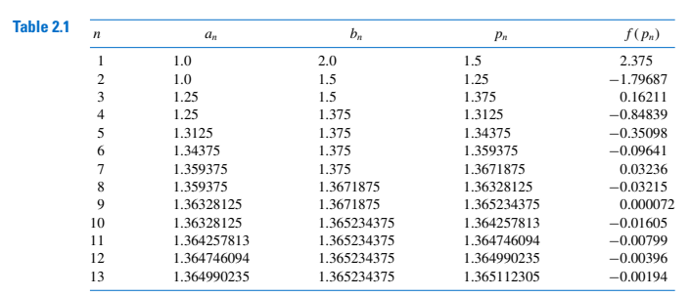
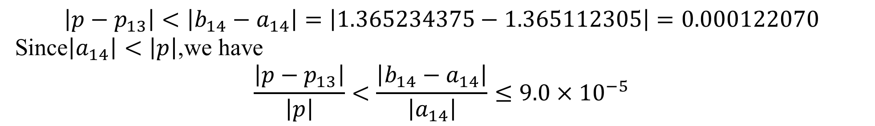
DLI
$$\left|p−p_{13}\right|<\left|b_{14}−a_{14}\right|=\left|1.365234375−1.365112305\right|=0.000122070$$
Since$\left|a_{14}\right|<\left|p\right|$,we have
$$\frac{\left|p−p_{13}\right|}{\left|p\right|}<\frac{\left|b_{14}−a_{14}\right|}{\left|a_{14}\right|}≤9.0×{10}^{−5}$$
so the approximation is correct to at least within 10⁻⁴

Slide 16
DLI
Disadvantages of The Bisection method
The Bisection method has significant drawbacks.
It is relatively slow to converge.
a good intermediate approximation might be inadvertently discarded.
Advantages of dichotomy
conceptually clear
it always converges to a solution, it is often used to find the original value of the other methods.

Slide 17
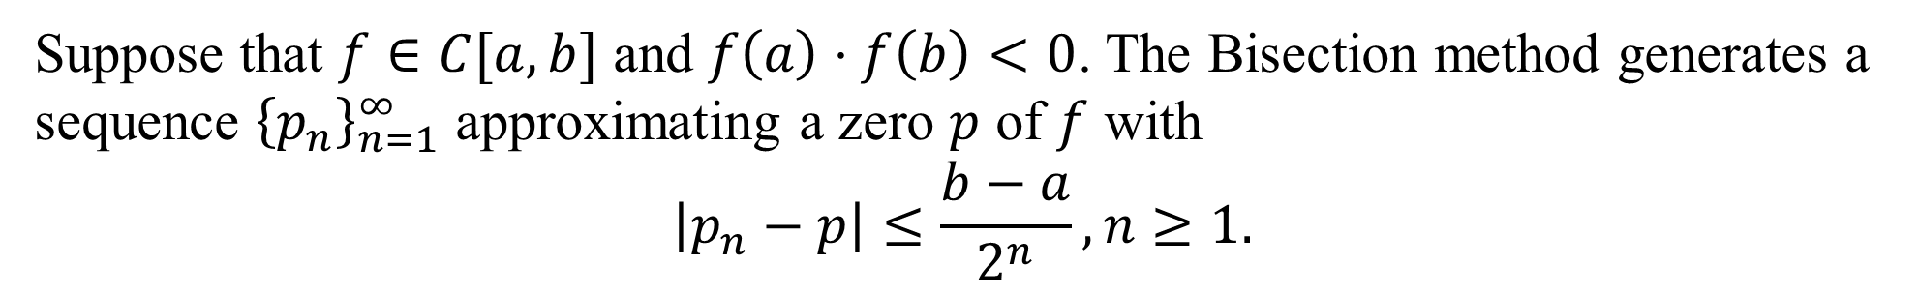
DLI
Theorem 2.1
Suppose that $f∈C[a,b]$ and $f\left(a\right)⋅f\left(b\right)<0$. The Bisection method generates a sequence ${\left\{p_{n}\right\}}_{n=1}^{∞}$ approximating a zero $p$ of $f$ with
$$\left|p_{n}−p\right|≤\frac{b−a}{2^{n}}, n≥1.$$

Slide 18

DLI
Note: Theorem 2.1 gives only a bound for approximation error and that this bound might be quite conservative.
In example 1:
$$\left|p−p_{9}\right|≤\frac{2−1}{2^{9}}≈2×{10}^{−3}$$
But the actual error is
$$\left|p−p_{9}\right|=\left|1.365230013−1.365234375\right|≈4.4×{10}^{−6}$$

Slide 19
DLI
Example 2
Determine the number of iterations necessary to solve $f\left(x\right)=x^{3}+4x^{2}−10=0$ with accuracy ${10}^{−3}$ using $a_{1}=1$ and $b_{1}=2$.

Slide 20

DLI
When implementing the method on a computer, we need to consider the effects of round-off error.
For example the computation of the midpoint of the interval [an, bn] should be found from the equation
$$p_{n}=a_{n}+\frac{b_{n}−a_{n}}{2} instead of p_{n}=\frac{a_{n}+b_{n}}{2}$$
The first equation adds a small correction, (b_{n} −a_{n})/2, to the known value a_{n}.
When b_{n} −a_{n} is near the maximum precision of the machine, this correction might be in error.
when b_{n}−a_{n} is near the maximum precision of the machine, it is possible for (a_{n} + b_{n})/2 to return a midpoint that is not even in the interval [a_{n}, b_{n}]

Slide 21
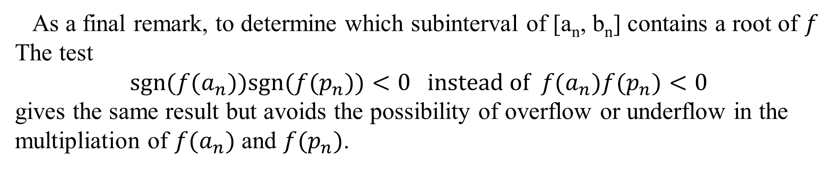
DLI
As a final remark, to determine which subinterval of [a_{n}, b_{n}] contains a root of $f$
The test
$$sgn(f(a_{n}))sgn(f(p_{n}))<0 instead of f(a_{n})f(p_{n})<0$$
gives the same result but avoids the possibility of overflow or underflow in the multipliation of $f(a_{n})$ and $f(p_{n})$.

